Slide 1
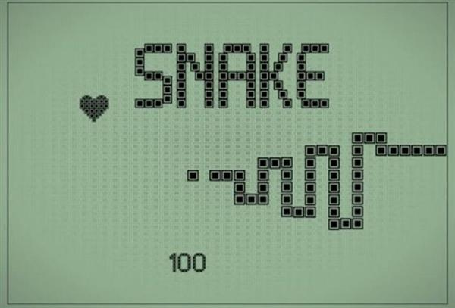
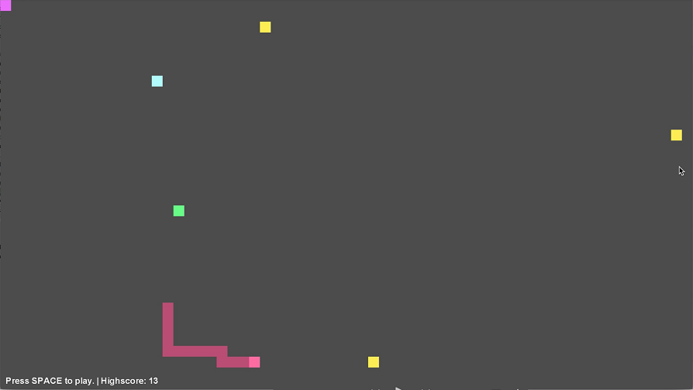
Micro-snake
Presented by: Crystal Chang
Patrick Chen
Nicole Meng
Jason Zhang
Hack The Burgh 19/03/2017

Slide 2
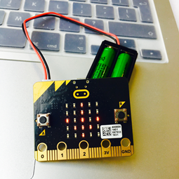
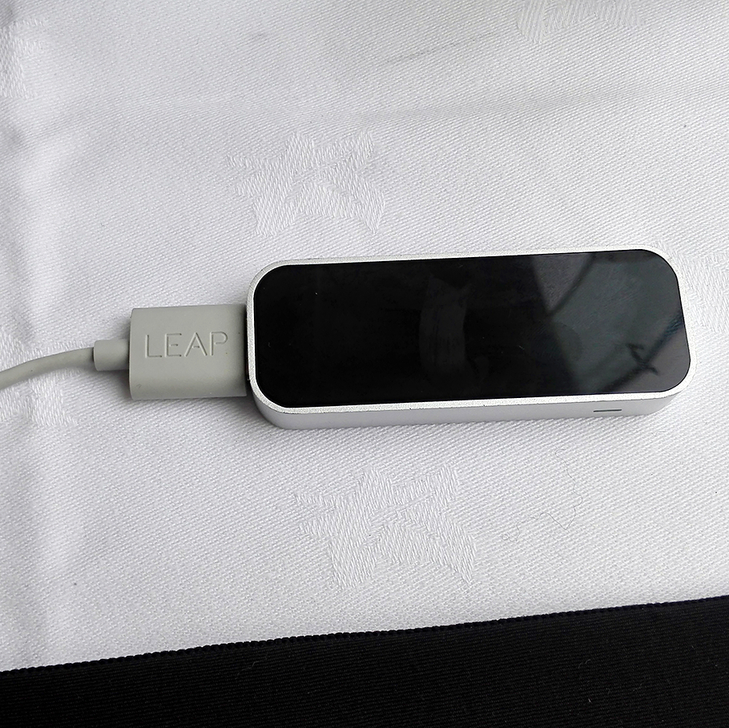
What Technology?
Play the Game!
Edge Cases?
Limitations / Future Work!

Slide 3
Motion: Keyboard/ Leap Motion/ Micro:Bit – accelerometer
Retro - multiplayer
Leap Motion
Micro:Bit
Keyboard

Slide 4
Simple rules!
How to start with Micro:Bit?
tilt left/ tilt right/ logo up/ logo down
What about Leap Motion?
Left hand – direction of palm
Supports Keyboard?
Of course! try left/ right/ up/ down or “wasd”

Slide 5
Motion: Keyboard/ Leap Motion/ Micro:Bit - accelerometer
Communication: Micro:Bit - Radio
Server: on AWS
Leap Motion
Micro:Bit
Keyboard

Slide 6
Edge Cases
Going to the direction you come from
Bumping into other snakes / yourself

Slide 7
Limitations / Future Work
Speed of snake
Sensitivity (reaction time) / accuracy of micro:bit

Slide 8
Special Thanks to the Gurus:
Harry and Sammy
And, of course, GitHub user
@DeerMichel

Slide 9

Thank You For Your Time!

